Slide 1

Analyzing College Affordability using a Distributed Data Science Pipeline
AffordableU Foundation
Ben Ogle, Logan Van Dine, and Jacqueline Vo
Notes:
Hello! My name is Logan Van Dine, and today I am lucky to work alongside Ben Ogle and Jacqueline Vo. Thank you for joining us today to discuss the upward trend of college tuition and a graduating high school senior’s ability to enroll and attend a desired four year university.

Slide 2
Problem Statement
Between 1980 to 2020, college tuition has increased by 169% (Carnevale et al., 2022)
College tuition poses a financial obstacle to many students
Notes:
Between 1980 and 2020, the average price of tuition, fees, and room and board for an undergraduate degree increased 169%, according to a recent report from the Georgetown University Center on Education and the Workforce. This uptick in cost of living to attend a top tier University can pose as a monumental financial burden for graduating seniors. AffordableU Foundation is dedicated to providing the opportunity of an affordable higher education to these graduating seniors that may be in underprivileged financial situations.
Ultimately, attending University will provide these potential low-income populations with the tangible skills to pursue higher-earning careers that can further provide monetary and educational support to their families. Having a society of individuals with different backgrounds, who are skilled workers, will mold a society that can provide citizens with a higher quality of life.
https://www.insidehighered.com/news/2022/09/29/new-study-explores-why-people-drop-out-or-dont-enroll
Carnevale, A., Gulish, A., & Peltier-Campbell, K. (2022). If not now, when?: The urgent need for an All-One-System approach to youth policy. In Georgetown University Center on Education and the Workforce. https://cew.georgetown.edu/cew-reports/allonesystem/

Slide 3
Goals
Identify universities that can provide the highest ROI for disadvantaged students
Enhance college entry by 15% for high school students in 10 target schools with low graduation rates.
Prescriptive analytics: personalized recommendations
Predictive analytics: what factors influence affordability?
Notes:
The first step in assisting high school students is identifying affordable Universities based on a number of specific characteristics both personal to the student and also of the desired Universities. Ultimately, AffordableU Foundation is striving to provide University recommendations to these young adults that have a high return on investment to their quality of life and their education.
Upon the beginning stages of deployment, the foundation hopes to enhance the college entry rates for high school students by 15% for those high schools with low graduation rates. The team will utilize prescriptive analytics to provide personalized recommendations to low-income graduating high school seniors. Predictive analytics models will be used to determine the factors that influence affordability and ultimately deem these Universities as affordable or not.

Slide 4
Raw Data Sources
Kaggle
University information
TuitionTracker
Sticker price (2011-2021)
Net price after grants and scholarships (2011-2021)
U.S. Department of Agriculture
Estimated unemployment rate (2000-2022)
Estimated poverty rate (2003, 2013, 2021)
Notes:
Multiple datasources were researched and ultimately outsourced to assist in the prescriptive and predictive analytics models to be created.
Kaggle Inc. provided general University information such as geographic information, admission requirements, total tuition costs, etc.
Secondly, the team outsourced from the United States Department of Agriculture for two datasets providing census unemployment data of years 2000 through 2022. The U.S. Department of Agriculture also provided census data of poverty rates for years 2003, 2013, and 2021. These datasets provide a general understanding of the population incomes to be factored in as potential student demographics in the predictive modeling.
Lastly, TuitionTracker provided the sticker price and net price after grants and scholarships of renowned Univeristies.

Slide 5
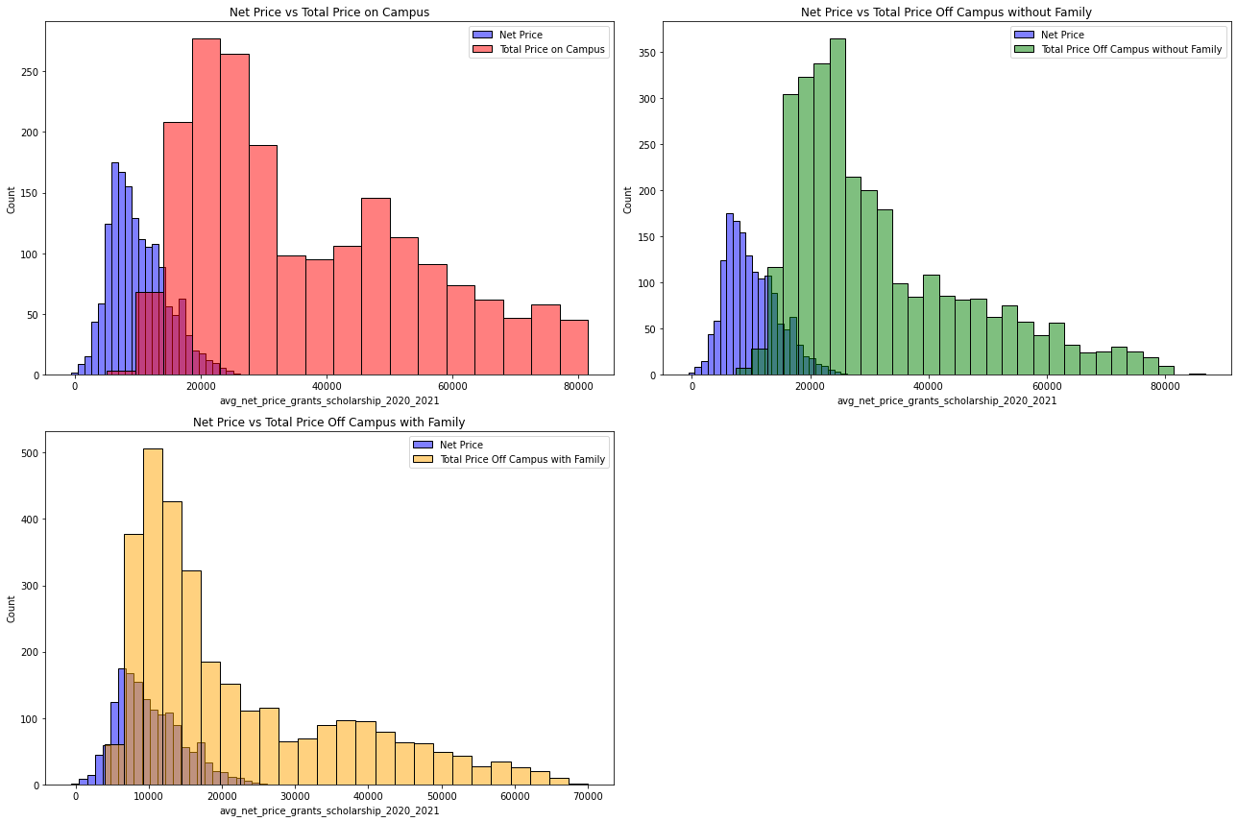
Data Exploration
Figure 1. Histogram of Sticker Price vs. Net Price (2020-2021)
Notes:
As Logan mentioned, we had five datasets and combined them into one to analyze. Before modeling, we did exploratory data analysis.
Figure 1 displays variations in tuition based on living arrangements, with red, green, and yellow graphs showing costs for on-campus, off-campus without family, and with family. Blue bars represent net price after aid.
Commuter students align closest to net price, while on-campus or off-campus without family face higher costs.

Slide 6
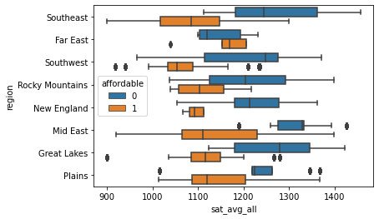
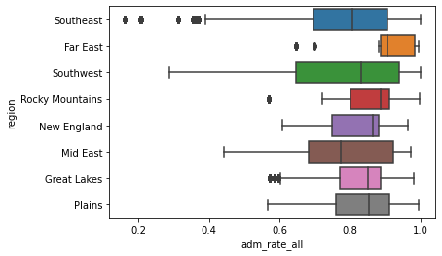
Data Exploration (cont.)
Figure 2. Boxplot of Region, SAT Average, and Affordability
Figure 3. Boxplot of Region and Admission Rates
Notes:
Additionally, we analyze how region affects different aspects of university such as SAT scores, admission rates, and affordability.
Figure 2 illustrates the relationship between U.S. regions and the average SAT scores of admitted students for universities that were identified as either unaffordable or affordable. It can be observed that generally, unaffordable universities accepted students that generally had a higher SAT score with the exception of the Far East regions.
In Figure 3, we see the relationship between U.S. regions and the general admissions rate. The Southeast, having a wider range of admissions rates, implying these universities might be less selective. On the other hand, the Far West might have the most selective universities.

Slide 7
Features
Target Feature: Affordability
Prediction Features:
Admissions Rate
Average SAT
Average annual total cost of attendance
In-state tuition cost
Out-state tuition cost
Estimated number of people reported in poverty
Median household income
Unemployment rate
U.S. region
Notes:
We built our models to predict the affordability of universities on different factors. The target features, or variable that would be predicted, would either be true or false. This was calculated by identifying calculating the average annual gross income, and the average amount of debt that would be expected out of college, then determining whether this amount exceeded 10% of their income.
With our combined dataset, we originally had 388 different variables, but refined our dataset to only include key features that might influence affordability within universities. This led total of 56 features that would relate to [reading prediction features here].

Slide 8
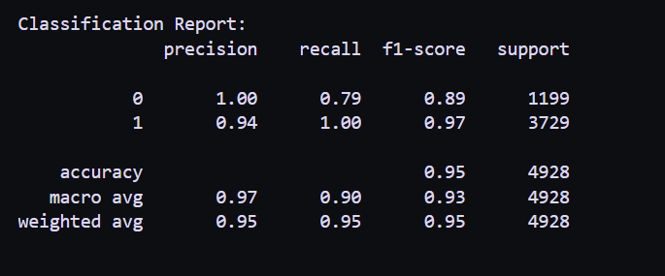
Models
Logistic Regression Model
XGBoost Model utilizing Hyperparameters
Random Forest Model
Random Forest Model

Slide 9
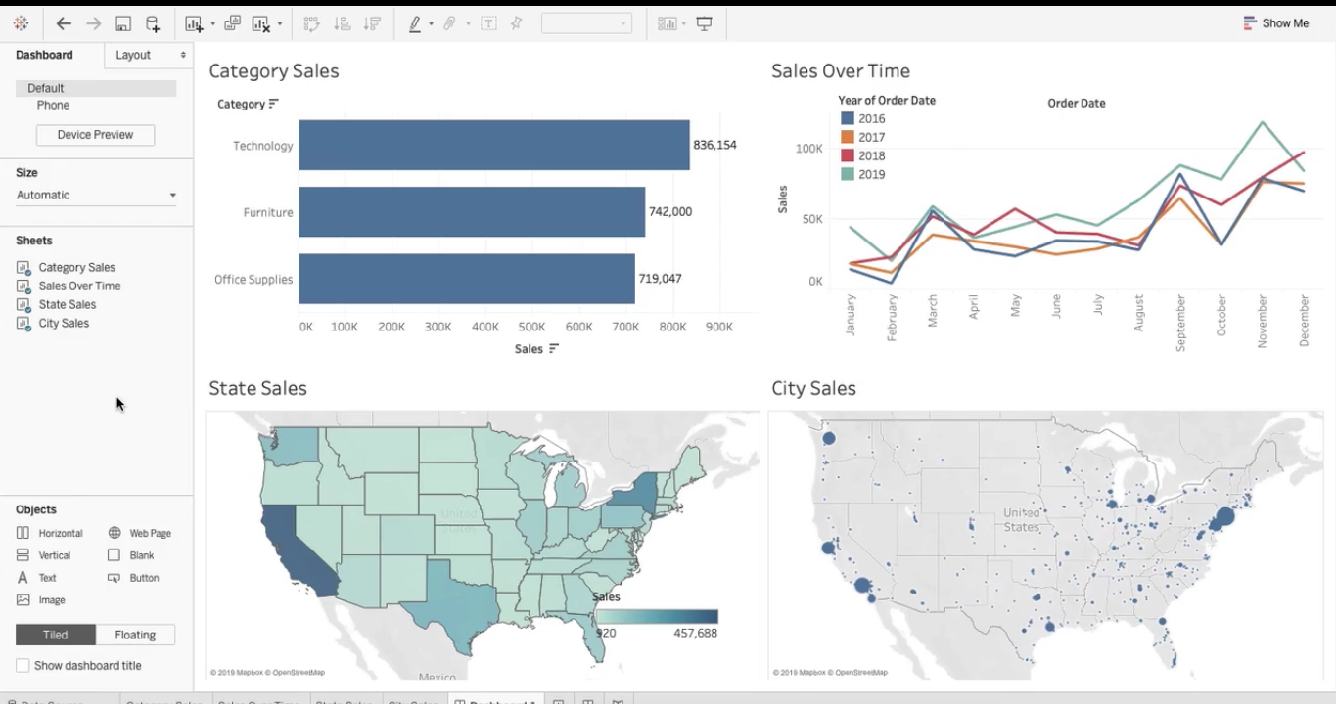
Future Enhancements
Creating and evaluating with more models
Individual, personal demographic info per student
Dashboards of recommendations

